Slide 1
Newcomer- Emerging Tic-Tac-Toe Choice Board
Directions: Start with number ____ and then make two other choices to make your tic-tac-toe.
1. Oral Retell | 2. My favorite…. | 3. Describe
4. Main Idea | 5. Teacher Choice | 6. Compare
7. Explore | 8. Word Study | 9. What’s your Opinion?

Slide 2
Activity # 1 The main idea is the most important information in a text, picture, or graphic.
The main idea is_________. One detail is ________. Another detail is______.

Slide 3
Activity #2 Sing Along and Dance
Click

Slide 4
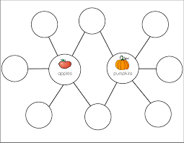
Activity # 4
How are they the same and different.
______and ____ are alike because_______. They are different because______ and ______.

Slide 5
Activity #4 How are __________different?
Use the frames to respond.
__ is ___ , but ___ is ___.
I see ___ and ___ in ____.
Share your ideas with someone or post video on Flipgrid/ClassDojo.

Slide 6
Activity #5 Write the word part: ____
___
1. Add the letter to ___ to make new words.
2. Say or write the words.
3. Draw a picture of one -ag word.

Slide 7
Activity #6 An opinion tells what someone thinks, feels, or believes.
Which is _______________?
Use the frames to help you answer.
In my opinion ____ is better because ______.
I think ____ is better because __.
I feel _____ is better because ___.

Slide 8
Activity #7 Think about who, what, when, where ,why and how.
Directions:
Write two sentences about what is happening in the picture.

Slide 9
Activity #8 Give two reasons why
What is your favorite ______? _____________? Why do you like it? What do you like ________?
Draw a picture. Write/dictate a sentence to an adult.
The best _______ is __ because __________.
I like to ____ in _____.

Slide 10
Activity #9
Read a book to or with your family. Take turns asking questions about the story.
Share what you liked or disliked on ClassDojo.

