Slide 1
Our Goals Today: Discuss two (related) topics
Academic Language: Making Space for Student Voices
Three panelists
Paola Uccelli
Gladys Aguilar
Catherine Snow
Academic language: what is it? What is it good for?
Student voice: what does it have to do with learning or reading comprehension?

Slide 2
AL: the language for school literacy
What it is NOT
It is NOT standard English
It does NOT emerge from a prescriptive approach that seeks to impose rules
It does NOT focus on correcting grammar
It is NOT a prerequisite for content area learning
It is NOT superior to other ways of using language; nor a replacement for students’ out-of-school languages
It is NOT categorically distinct from other ways of using language
What it IS?
It is a collection of language resources useful to support scientific communication and learning
It emerges from FUNCTIONAL approaches that describe which language resources are used recurrently in content-area texts
It focuses on MEANINGS and on supporting the understanding and expression of IDEAS
It is learned through participation in content-area reading, writing, discussion, and learning
It is just useful for some purposes and contexts
It is part of the continuum of hybrid, fluid language use; a collection of resources inseparable from the multiple language resources one has learned

Slide 3
SERP’s Word
Generation
CSEL’s World
Generation
18 one-week units
Designed for 6th through 8th graders
Big ideas presented in age-appropriate ways
Units start with Readers Theater
Each unit organized around a debatable topic
Focus on understanding speaker’s/writer’s perspective
Efforts to build vocabulary, argumentation skills, reading comprehension
Discussion a part of every session
4 two-week units
Designed for 6th, 7th, or 8th graders
Big ideas presented in age-appropriate ways
Units start with background information
Each unit organized around a debatable topic
Focus on understanding speaker’s/writer’s perspective
Efforts to build vocabulary, argumentation skills, reading comprehension
Discussion a part of every session
Reduced text length and density

Slide 4
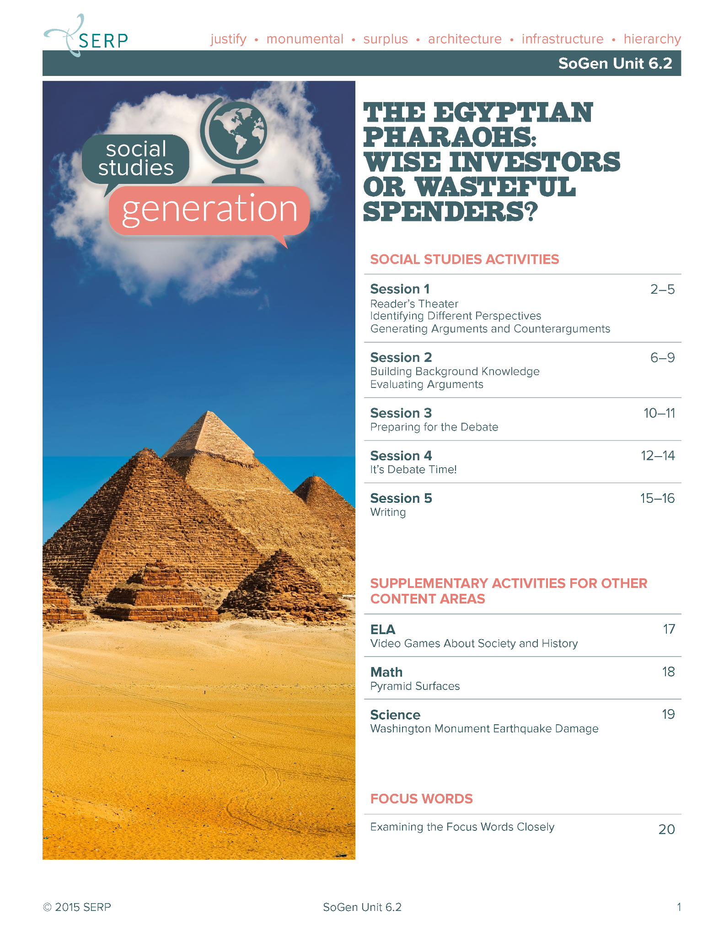
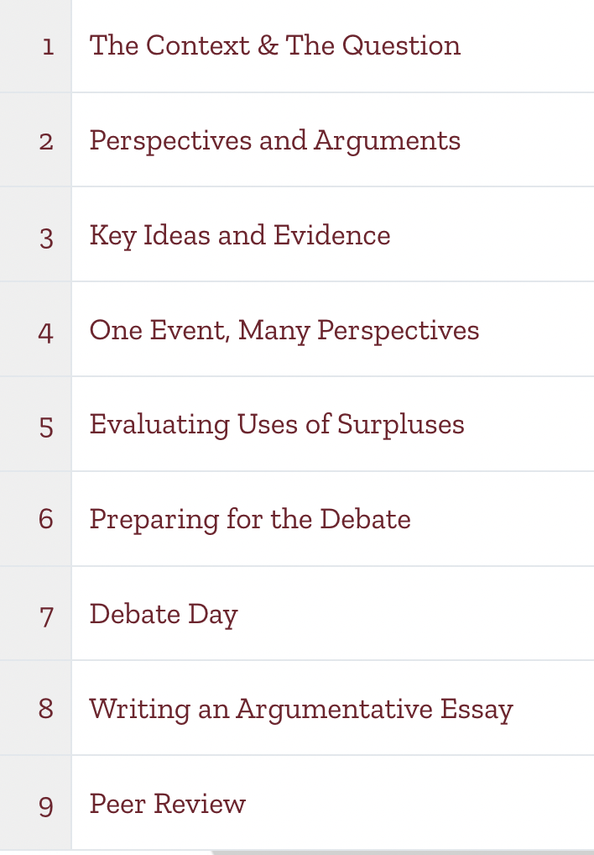

Slide 5
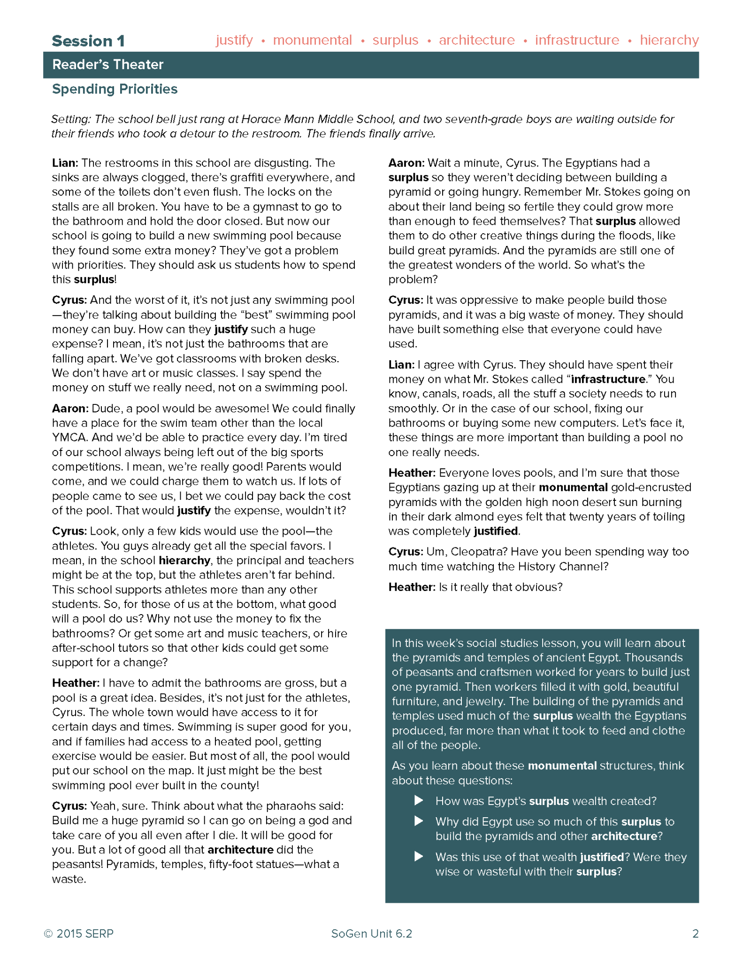
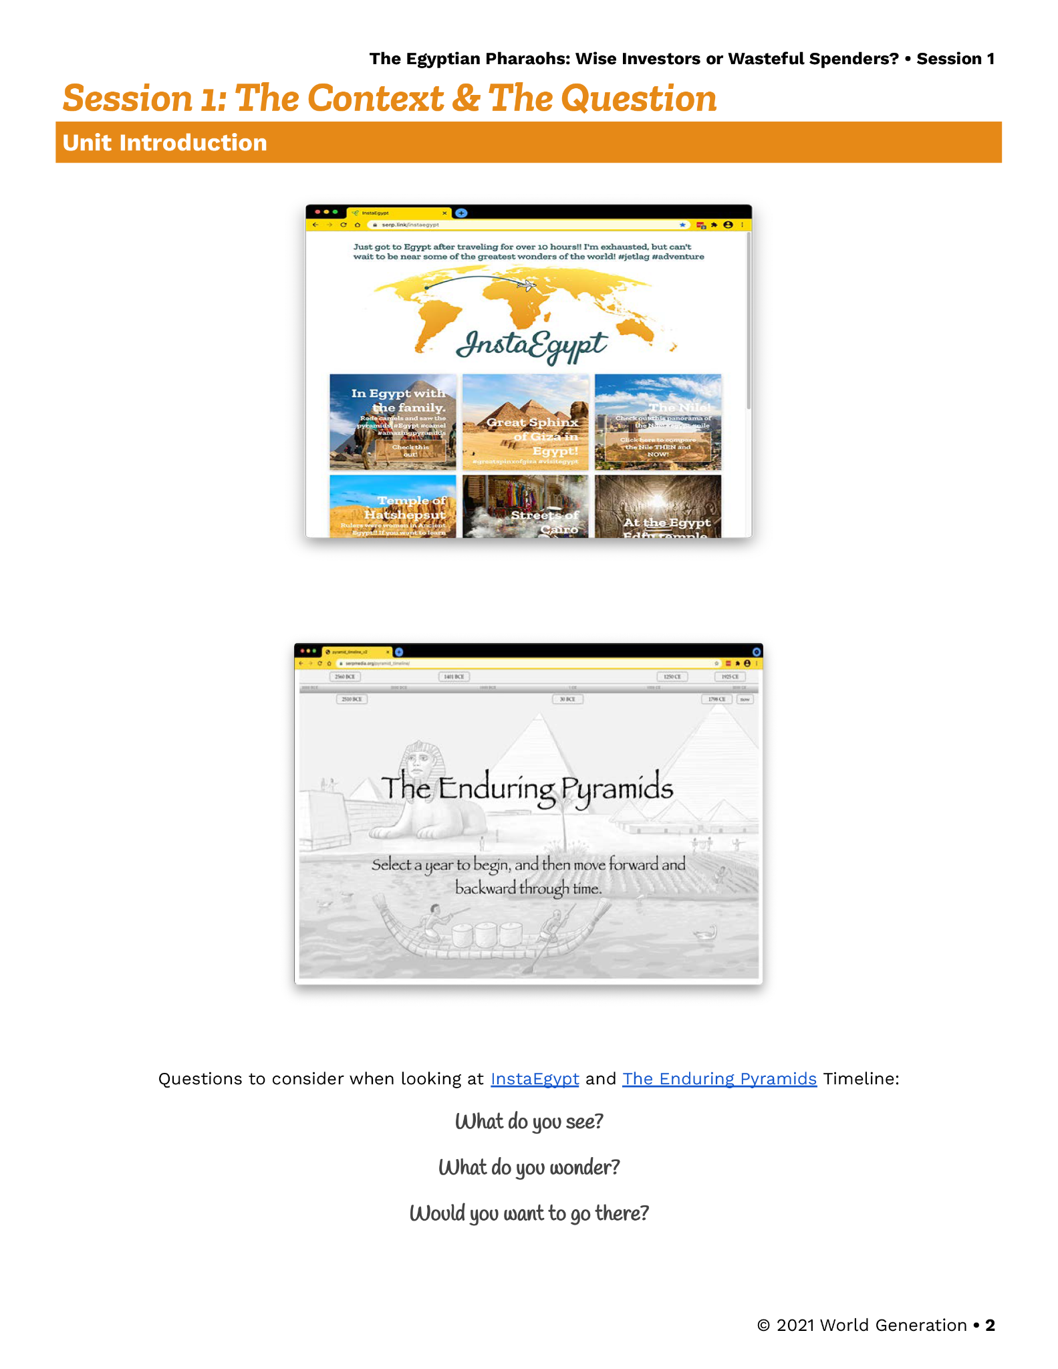
Session 1
Session 1

Slide 6
Participation & Engagement Supporting ALL learners’ voices
Big open-ended question for debate (with no correct answer, yet with room for more informed, evidence-based answers that integrate multiple perspectives)
Relevant for students (and for the unit) and discussed first in a familiar student context (Should a school build a swimming pool?)
Answers require collective effort and sharing multiple perspectives through discussion (scaffolds provided to support all students’ participation, e.g., explicit explanation of what is expected in a debate; sentence starters for oral debate and written argumentation)
CREATING THE CONDITIONS FOR SUCCESS: a classroom environment that welcomes students’ voices, in which students feel invested to learn new content and new language as expansions (not as replacement) of who they are

Slide 7
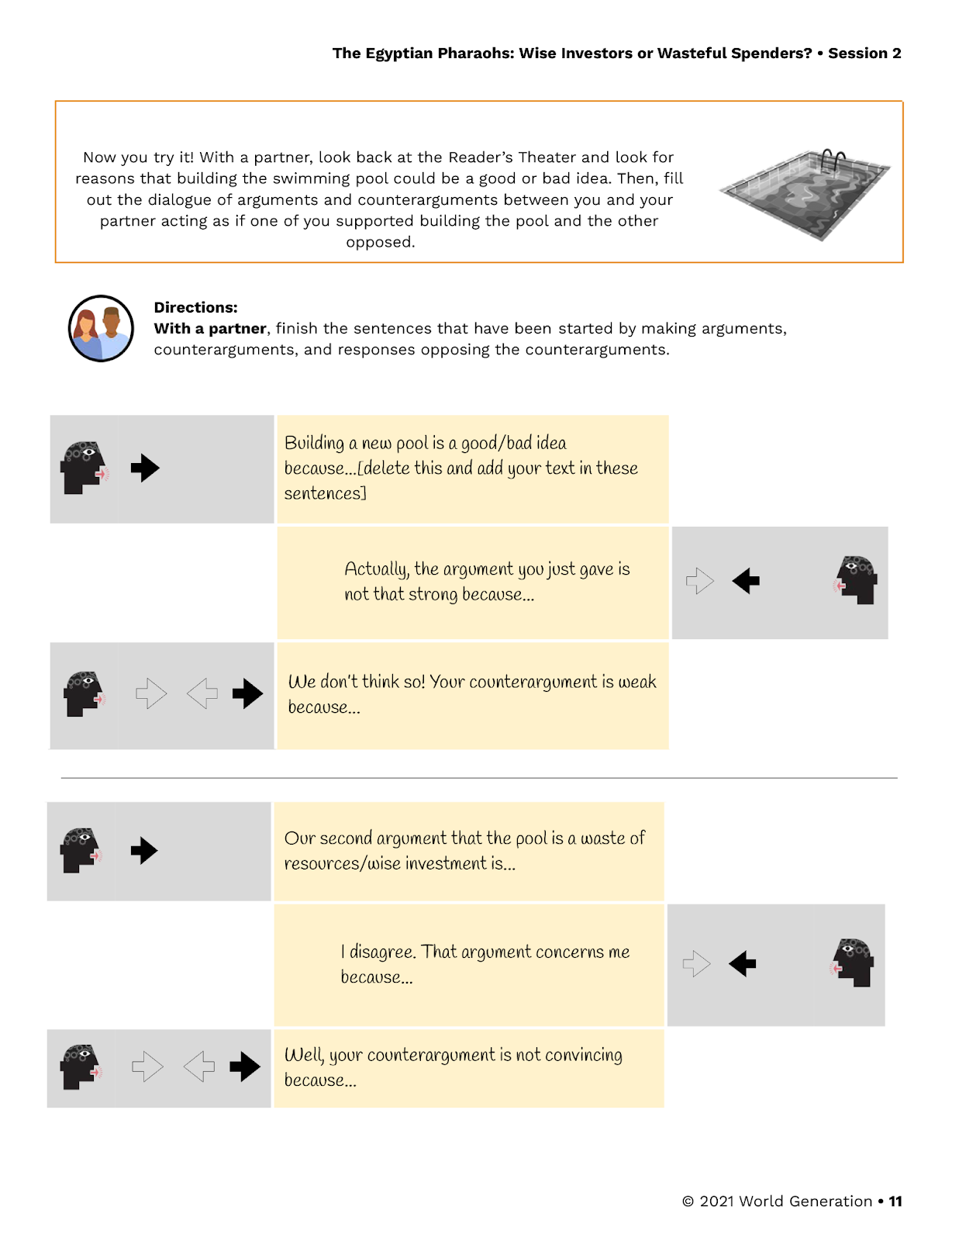
Scaffolding language development Affirming and expanding language resources
Plenty of opportunities to use language in authentic and cognitively demanding, yet supported, academic practices
Students’ home language resources are welcome to support their voices and learning (e.g., students can debate in their home language, then report in English to the class; all their oral language resources are welcome as they understand new content and communicate their own ideas)
Explicit support embedded in big questions and authentic tasks that promote discussion of content and practicing new language
Sentence starters support learning highly useful language resources for argumentation (I disagree. That argument concerns me because…)
CREATING THE CONDITIONS FOR SUCCESS: Focus is on students’ ideas FIRST, then on expanding language that support students’ understanding and expression of ideas

Slide 8
Why so many students do not understand the texts they read at school?

Slide 9
the content and language of disciplinary texts are challenging for many
students bring their more conversational
language
disciplinary texts contain more information-dense
language
school texts
students bring the knowledge, values, expectations of their families and communities
students are expected to learn the knowledge, values, and practices of school and scientific reasoning

Slide 10
students bring their more conversational
language
reading & writing to learn
school texts contain
more information-dense
language
Hey, I don’t like that, so let’s not do it that way!
The available scientific evidence has shown that this approach is likely to be the most effective. Consequently…
HYPOTHESIS:
individual differences in understanding the language of school texts
would help explain why students struggle with reading comprehension

Slide 11
PRIOR INTERVENTIONS
Word recognition skills (e.g., mechanics of reading)
Reading comprehension strategies (e.g., predicting,
summarizing, finding main idea)
Vocabulary interventions (e.g., teaching word meanings)
IMPORTANT BUT
INSUFFICIENT
Discussion of texts and controversial ideas improves students’ reading and writing
(Al-Adeimi & O’Connor, 2021; Jones et al., 2019; Murphy, et al., 2009)
WHY?

Slide 12
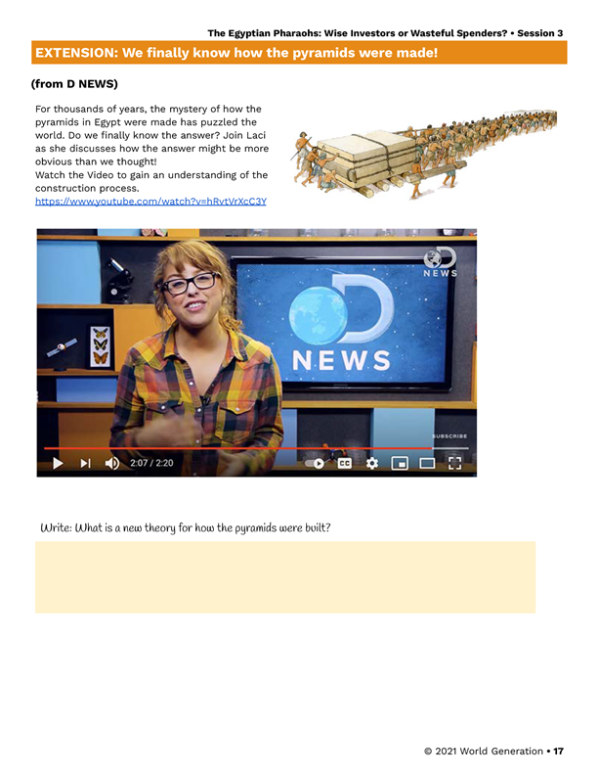
(2) We Finally Know How The Pyramids Were Made! - YouTube

Slide 13
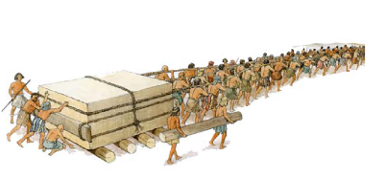
It's a question that's plagued
scientists for decades: How the heck did
the Egyptians build the pyramids?
I can barely build a Lego house!
The Egyptian pyramids are one of the seven
wonders of the ancient world. And
humanity has been wondering how on earth
did these ancient people manage to move
two-and-a-half-ton stones and statues…
Dutch scientists believe that the
Egyptians likely carried the blocks on
sleds pulled by hundreds of workers...
As the sled moved, they would pour the
water in front of it to ease the sliding friction
of the sand. By pouring just enough water
onto the sand, they cut the force
required to move the sled in half.
An international team based out of
Amsterdam tested the theory using
downsize models in a lab…
A wall painting found in one of the tombs
shows a worker pouring water in front of
the sled as people pulled.
Until now, Egyptologists mistakenly interpreted
the painting as depicting an Egyptian purification
ritual with water, not revealing the technicalities of
one of humanity's greatest architectural accomplishments
Lacy Green (July 2014)
https://www.youtube.com/watch?v=hRvtVrXcC3Y

Slide 14
It's a question that's plagued
scientists for decades: How the heck did
the Egyptians build the pyramids?
I can barely build a Lego house!
The Egyptian pyramids are one of the seven
wonders of the ancient world. And
humanity has been wondering how on earth
did these ancient people manage to move
two-and-a-half-ton stones and statues…
Dutch scientists believe that the
Egyptians likely carried the blocks on
sleds pulled by hundreds of workers...
As the sled moved, they would pour the
water in front of it to ease the sliding friction
of the sand. By pouring just enough water
onto the sand, they cut the force
required to move the sled in half.
An international team based out of
Amsterdam tested the theory using
downsize models in a lab…
A wall painting found in one of the tombs
shows a worker pouring water in front of
the sled as people pulled.
Until now, Egyptologists mistakenly interpreted
the painting as depicting an Egyptian purification
ritual with water, not revealing the technicalities of
one of humanity's greatest architectural accomplishments
Tracking participants & themes

Slide 15
It's a question that's plagued
scientists for decades: How the heck did
the Egyptians build the pyramids?
I can barely build a Lego house!
The Egyptian pyramids are one of the seven
wonders of the ancient world. And
humanity has been wondering how on earth
did these ancient people manage to move
two-and-a-half-ton stones and statues…
Dutch scientists believe that the
Egyptians likely carried the blocks on
sleds pulled by hundreds of workers...
As the sled moved, they would pour the
water in front of it to ease the sliding friction
of the sand. By pouring just enough water
onto the sand, they cut the force
required to move the sled in half.
An international team based out of
Amsterdam tested the theory using
downsize models in a lab…
A wall painting found in one of the tombs
shows a worker pouring water in front of
the sled as people pulled.
Until now, Egyptologists mistakenly interpreted
the painting as depicting an Egyptian purification
ritual with water, not revealing the technicalities of
one of humanity's greatest architectural accomplishments
Tracking participants & themes

Slide 16
It's a question that's plagued
scientists for decades: How the heck did
the Egyptians build the pyramids?
I can barely build a Lego house!
The Egyptian pyramids are one of the seven
wonders of the ancient world. And
humanity has been wondering how on earth
did these ancient people manage to move
two-and-a-half-ton stones and statues…
Dutch scientists believe that the
Egyptians likely carried the blocks on
sleds pulled by hundreds of workers...
As the sled moved, they would pour the
water in front of it to ease the sliding friction
of the sand. By pouring just enough water
onto the sand, they cut the force
required to move the sled in half.
An international team based out of
Amsterdam tested the theory using
downsize models in a lab…
A wall painting found in one of the tombs
shows a worker pouring water in front of
the sled as people pulled.
Until now, Egyptologists mistakenly interpreted
the painting as depicting an Egyptian purification
ritual with water, not revealing the technicalities of
one of humanity's greatest architectural accomplishments
Tracking participants & themes

Slide 17
It's a question that's plagued
scientists for decades: How the heck did
the Egyptians build the pyramids?
I can barely build a Lego house!
The Egyptian pyramids are one of the seven
wonders of the ancient world. And
humanity has been wondering how on earth
did these ancient people manage to move
two-and-a-half-ton stones and statues…
Dutch scientists believe that the
Egyptians likely carried the blocks on
sleds pulled by hundreds of workers...
As the sled moved, they would pour the
water in front of it to ease the sliding friction
of the sand. By pouring just enough water
onto the sand, they cut the force
required to move the sled in half.
An international team based out of
Amsterdam tested the theory using
downsize models in a lab…
A wall painting found in one of the tombs
shows a worker pouring water in front of
the sled as people pulled.
Until now, Egyptologists mistakenly interpreted
the painting as depicting an Egyptian purification
ritual with water, not revealing the technicalities of
one of humanity's greatest architectural accomplishments
Tracking participants & themes

Slide 18
It's a question that's plagued
scientists for decades: How the heck did
the Egyptians build the pyramids?
I can barely build a Lego house!
The Egyptian pyramids are one of the seven
wonders of the ancient world. And
humanity has been wondering how on earth
did these ancient people manage to move
two-and-a-half-ton stones and statues…
Dutch scientists believe that the
Egyptians likely carried the blocks on
sleds pulled by hundreds of workers...
As the sled moved, they would pour the
water in front of it to ease the sliding friction
of the sand. By pouring just enough water
onto the sand, they cut the force
required to move the sled in half.
An international team based out of
Amsterdam tested the theory using
downsize models in a lab…
A wall painting found in one of the tombs
shows a worker pouring water in front of
the sled as people pulled.
Until now, Egyptologists mistakenly interpreted
the painting as depicting an Egyptian purification
ritual with water, not revealing the technicalities of
one of humanity's greatest architectural accomplishments
Tracking participants & themes

Slide 19
It's a question that's plagued
scientists for decades: How the heck did
the Egyptians build the pyramids?
I can barely build a Lego house!
The Egyptian pyramids are one of the seven
wonders of the ancient world. And
humanity has been wondering how on earth
did these ancient people manage to move
two-and-a-half-ton stones and statues…
Dutch scientists believe that the
Egyptians likely carried the blocks on
sleds pulled by hundreds of workers...
As the sled moved, they would pour the
water in front of it to ease the sliding friction
of the sand. By pouring just enough water
onto the sand, they cut the force
required to move the sled in half.
An international team based out of
Amsterdam tested THE THEORY using
downsize models in a lab…
A wall painting found in one of the tombs
shows a worker pouring water in front of
the sled as people pulled.
Until now, Egyptologists mistakenly interpreted
the painting as depicting an Egyptian purification
ritual with water, not revealing the technicalities of
one of humanity's greatest architectural accomplishments
Tracking participants & themes

Slide 20
It's a question that's plagued
scientists for decades: How the heck did
the Egyptians build the pyramids?
I can barely build a Lego house!
The Egyptian pyramids are one of the seven
wonders of the ancient world. And
humanity has been wondering how on earth
did these ancient people manage to move
two-and-a-half-ton stones and statues…
Dutch scientists believe that the
Egyptians likely carried the blocks on
sleds pulled by hundreds of workers...
As the sled moved, they would pour the
water in front of it to ease the sliding friction
of the sand. By pouring just enough water
onto the sand, they cut the force
required to move the sled in half.
An international team based out of
Amsterdam tested the theory using
downsize models in a lab…
A wall painting found in one of the tombs
shows a worker pouring water in front of
the sled as people pulled.
Until now, Egyptologists mistakenly interpreted
the painting as depicting an Egyptian purification
ritual with water, not revealing the technicalities of
one of humanity's greatest architectural accomplishments
Complex words (nominalizations: human> humanity; to force > a force; pure > purification; technical> technicality; to accomplish > accomplishment)

Slide 21
It's a question that's plagued
scientists for decades: How the heck did
the Egyptians build the pyramids?
I can barely build a Lego house!
The Egyptian pyramids are one of the seven
wonders of the ancient world. And
humanity has been wondering how on earth
did these ancient people manage to move
two-and-a-half-ton stones and statues…
Dutch scientists believe that the
Egyptians likely carried the blocks on
sleds pulled by hundreds of workers...
As the sled moved, they would pour the
water in front of it to ease the sliding friction
of the sand. By pouring just enough water
onto the sand, they cut the force
required to move the sled in half.
An international team based out of
Amsterdam tested the theory using
downsize models in a lab…
A wall painting found in one of the tombs
shows a worker pouring water in front of
the sled as people pulled.
Until now, Egyptologists mistakenly interpreted
the painting as depicting an Egyptian purification
ritual with water, not revealing the technicalities of
one of humanity's greatest architectural accomplishments
Tracking participants & themes
Complex words (nominalizations: human> humanity; to force > a force; pure > purification; technical> technicality; to accomplish > accomplishment)

Slide 22
It's a question that's plagued
scientists for decades: How the heck did
the Egyptians build the pyramids?
I can barely build a Lego house!
The Egyptian pyramids are one of the seven
wonders of the ancient world. And
humanity has been wondering how on earth
did these ancient people manage to move
two-and-a-half-ton stones and statues…
Dutch scientists believe that the
Egyptians likely carried the blocks on
sleds pulled by hundreds of workers...
As the sled moved, they would pour the
water in front of it (in order) to ease the sliding friction
of the sand. By pouring just enough water
onto the sand, they cut the force
required to move the sled in half.
An international team based out of
Amsterdam tested the theory using
downsize models in a lab…
A wall painting found in one of the tombs
shows a worker pouring water in front of
the sled as people pulled.
Until now, Egyptologists mistakenly interpreted
the painting as depicting an Egyptian purification
ritual with water, not revealing the technicalities of
one of humanity's greatest architectural accomplishments
Transition markers/Connectives
As (while)
As (like)
However
In contrast
Consequently
For instance
On the one hand… On the other hand
In conclusion
These markers are used by writers to facilitate comprehension, but if students do not know their functions, they become roadblocks

Slide 23
It's a question that's plagued
scientists for decades: How the heck did
the Egyptians build the pyramids?
I can barely build a Lego house!
The Egyptian pyramids are one of the seven
wonders of the ancient world. And
humanity has been wondering how on earth
did these ancient people manage to move
two-and-a-half-ton stones and statues…
Dutch scientists believe that the
Egyptians likely carried the blocks on
sleds pulled by hundreds of workers...
As the sled moved, they would pour the
water in front of it to ease the sliding friction
of the sand. By pouring just enough water
onto the sand, they cut the force
required to move the sled in half.
An international team based out of
Amsterdam tested the theory using
downsize models in a lab…
A wall painting found in one of the tombs
shows a worker pouring water in front of
the sled as people pulled.
Until now, Egyptologists mistakenly interpreted
the painting as depicting an Egyptian purification
ritual with water, not revealing the technicalities of
one of humanity's greatest architectural accomplishments
Markers of writer’s viewpoints (likely, mistakenly, plausibly, unlikely, it may be the case that, it’s a certain fact that…)

Slide 24
It's a question that's plagued
scientists for decades: How the heck did
the Egyptians build the pyramids?
I can barely build a Lego house!
The Egyptian pyramids are one of the seven
wonders of the ancient world. And
humanity has been wondering how on earth
did these ancient people manage to move
two-and-a-half-ton stones and statues…
Dutch scientists believe that the
Egyptians likely carried the blocks on
sleds pulled by hundreds of workers...
As the sled moved, they would pour the
water in front of it (in order) to ease the sliding friction
of the sand. By pouring just enough water
onto the sand, they cut the force
required to move the sled in half.
An international team based out of
Amsterdam tested THE THEORY using
downsize models in a lab…
A wall painting found in one of the tombs
shows a worker pouring water in front of
the sled as people pulled.
Until now, Egyptologists mistakenly interpreted
the painting as depicting an Egyptian purification
ritual with water, not revealing the technicalities of
one of humanity's greatest architectural accomplishments
Tracking participants & themes
Complex words
Transition markers/Connectives
Markers of writer’s viewpoints

Slide 25
A few crucial takeaways
Some language features are encountered frequently in school (and rarely in other contexts)
Because they are useful in particular communication tasks
Students benefit from knowing about those features
They don’t need to use them in their own spoken language
But participating in classroom discussions is one way to develop familiarity and fluency with them
These features are best learned by building on students’ engagement with content and their own language resources

