Slide 1
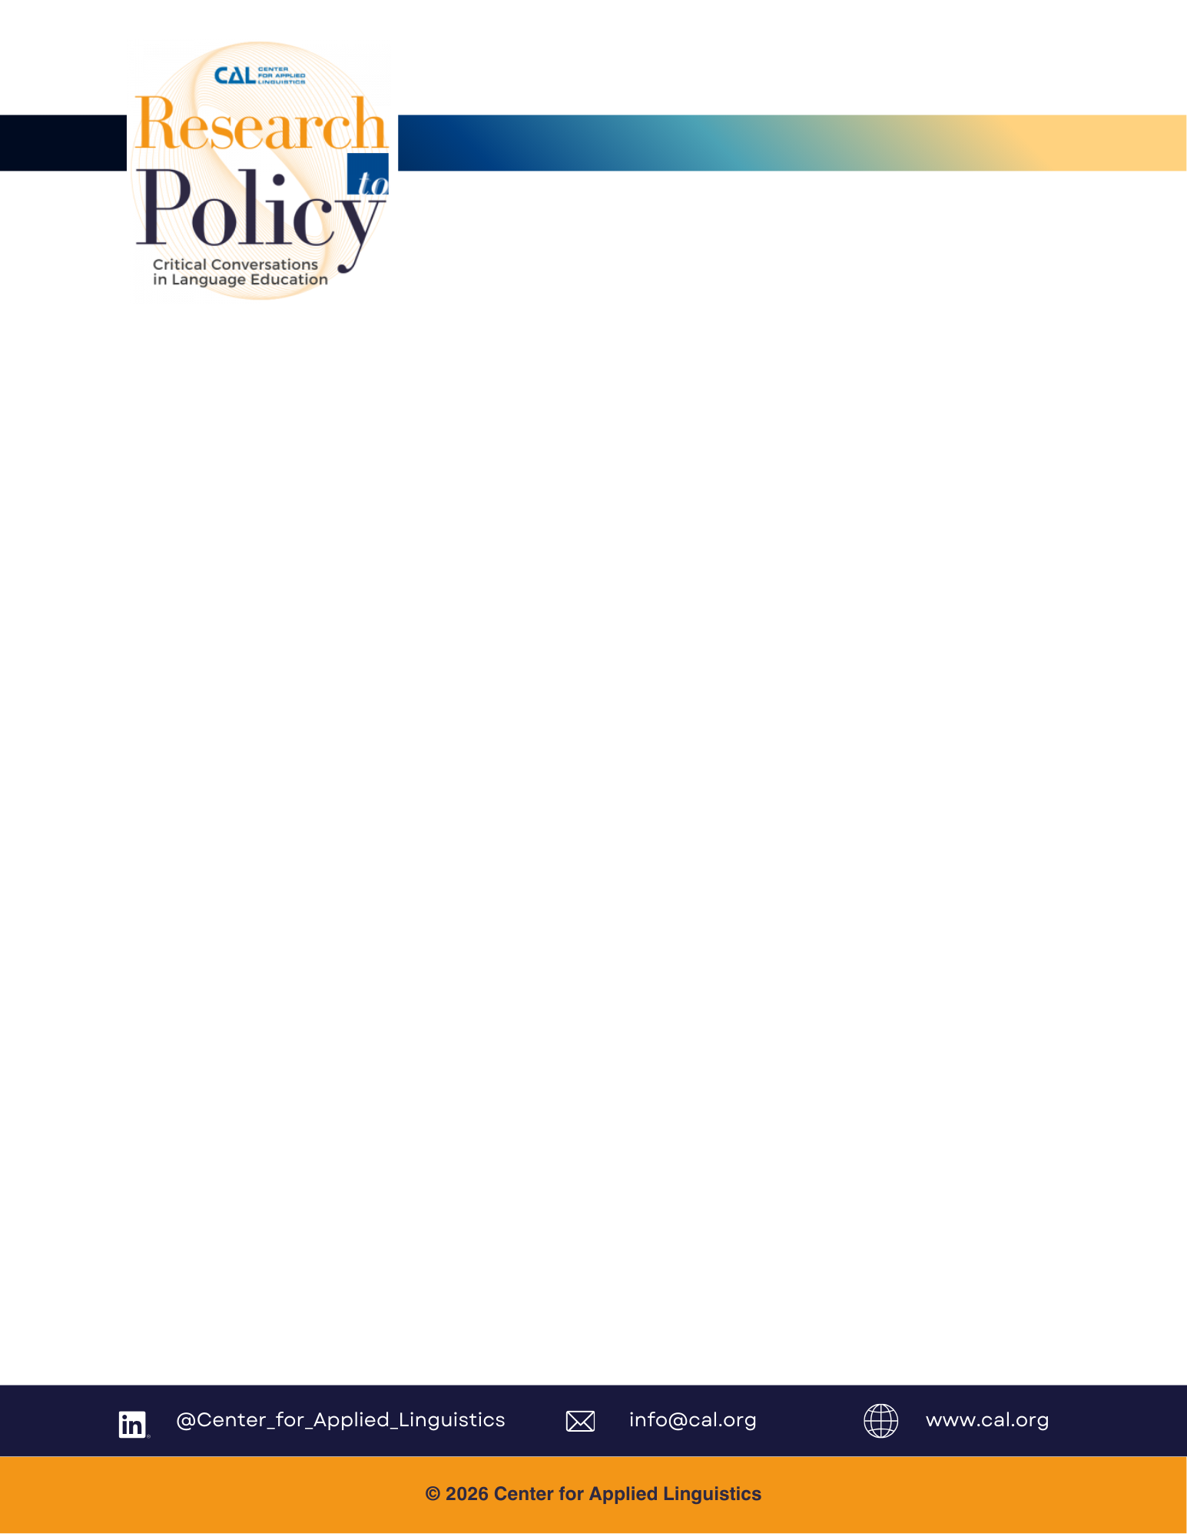
Universal Reading Screening and Multilingual Learners: Demystifying the Process
April 14, 2026
Webinar Guest Speaker
Lillian Durán, PhD, University of Oregon
Webinar Overview
Universal Screening for reading problems has been mandated across the country and despite growing populations of multilingual learners, little guidance has been provided about how to maximize accuracy and fairness in testing. The webinar will provide information to improve your screening practices by taking language proficiency and the language of instruction into consideration when planning an assessment approach and interpreting results. Myths and frequently asked questions will be addressed in a presentation designed to leave you with key actionable and practical takeaways.
Policy Implications
Nearly all 50 states have legislation in place regarding the universal screening of children for potential reading problems, yet few states have explicit guidelines regarding the screening of multilinguals.
Many states have approved lists of reading screeners and policy makers should include Spanish screeners on these lists.
Progress monitoring and documenting a child’s rate of growth in English reading skill development should be considered as a mechanism to identify if a child is in need of more targeted support. Given that we do not have appropriate screening tools for languages other than English or Spanish, policy makers should provide guidance in legislation that will result in more fair and accurate processes for determining risk with children who have emerging English proficiency.
CAL Disclaimer
The Center for Applied Linguistics (CAL) provides research-informed guidance to support equitable and effective education for multilingual learners. This document is intended for informational purposes only and does not constitute legal advice.

Slide 2

Key Insights
Reading screening with multilingual populations requires an understanding of the role of English language proficiency in English reading assessment performance.
The language or languages of reading instruction will influence performance on literacy-based measures.
We need to improve our approach to measuring language development in languages other than English to more accurately capture the abilities of multilingual children and the skills and knowledge they are bringing to the task of learning how to read in English.
Calls to Action
Recognize the limitations of English-only approaches to assessment and the likelihood that children’s abilities are underestimated when they cannot understand the language of assessment.
Innovation is needed in approaches to screening with the potential for using multiple sources of data to make informed decisions about the child’s aptitude for learning how to read. For multilingual children these data sources include a home language survey to better understand current language exposure, documenting progress over time to better understand the child’s learning trajectory, and information about the language or languages of reading instruction.
We need to challenge status quo approaches with the goal of maximizing accuracy in screening. More services are not always beneficial, especially if they are not a good fit for the child’s educational needs and if they come at a cost of labeling the child as “at-risk” when the risk is in the system that does not adequately or effectively address their language learning needs as multilingual children.
Resources
Durán, L. (2019). Biliteracy and Assessment. Podcast https://amplify.com/episode/science-of-reading-the-podcast/season-5/episode-2-biliteracy-and-assessment-with-dr-lillian-duran/
Cárdenas-Hagan, E. (2020). Literacy Foundations for English Learners: A Comprehensive Guide to Evidence-Based Instruction. Brookes Publishing Company. PO Box 10624, Baltimore, MD 21285.
Helman, L., Ittner, A. C., & McMaster, K. L. (2019). Assessing language and literacy with bilingual students: Practices to support English learners. Guilford Publications.
Mancilla‐Martinez, J., Hwang, J. K., & Oh, M. H. (2021). Assessment selection for multilingual learners’ reading development. The Reading Teacher, 75(3), 351-362.
CAL Disclaimer
The Center for Applied Linguistics (CAL) provides research-informed guidance to support equitable and effective education for multilingual learners. This document is intended for informational purposes only and does not constitute legal advice.

